Slide 1
step4_Tableau
File created on: 8/8/2022 8:57:14 PM

Slide 2
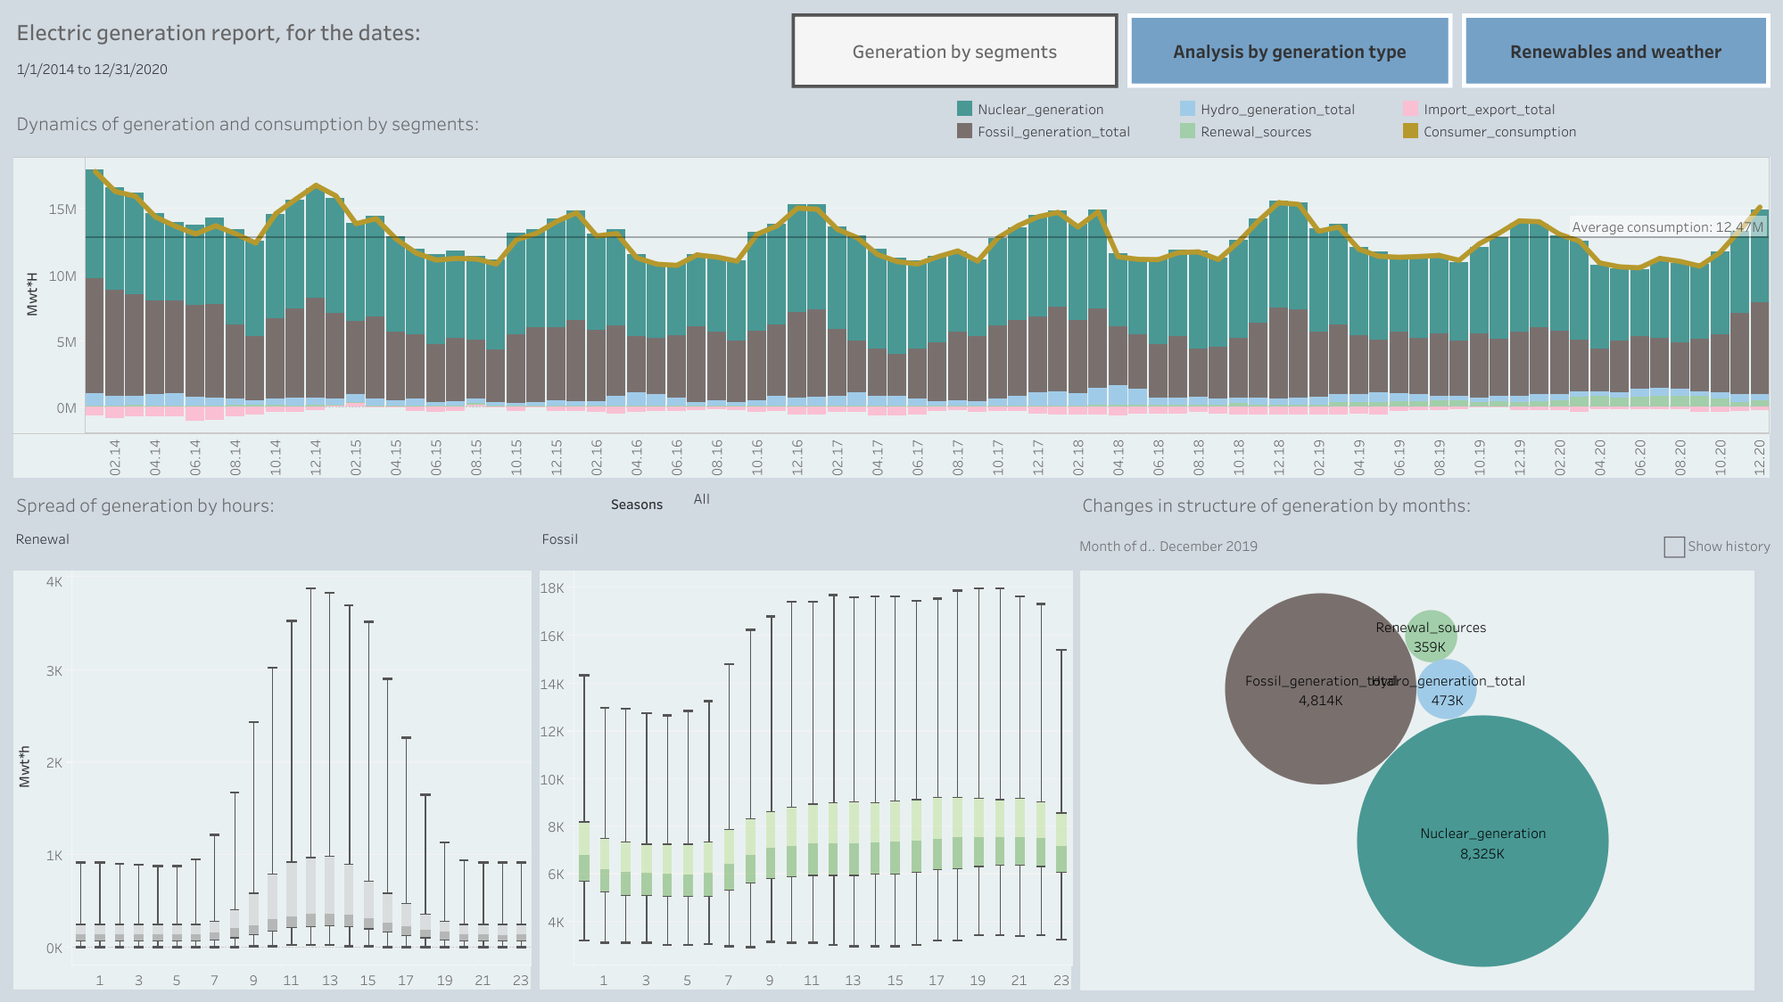

Slide 3
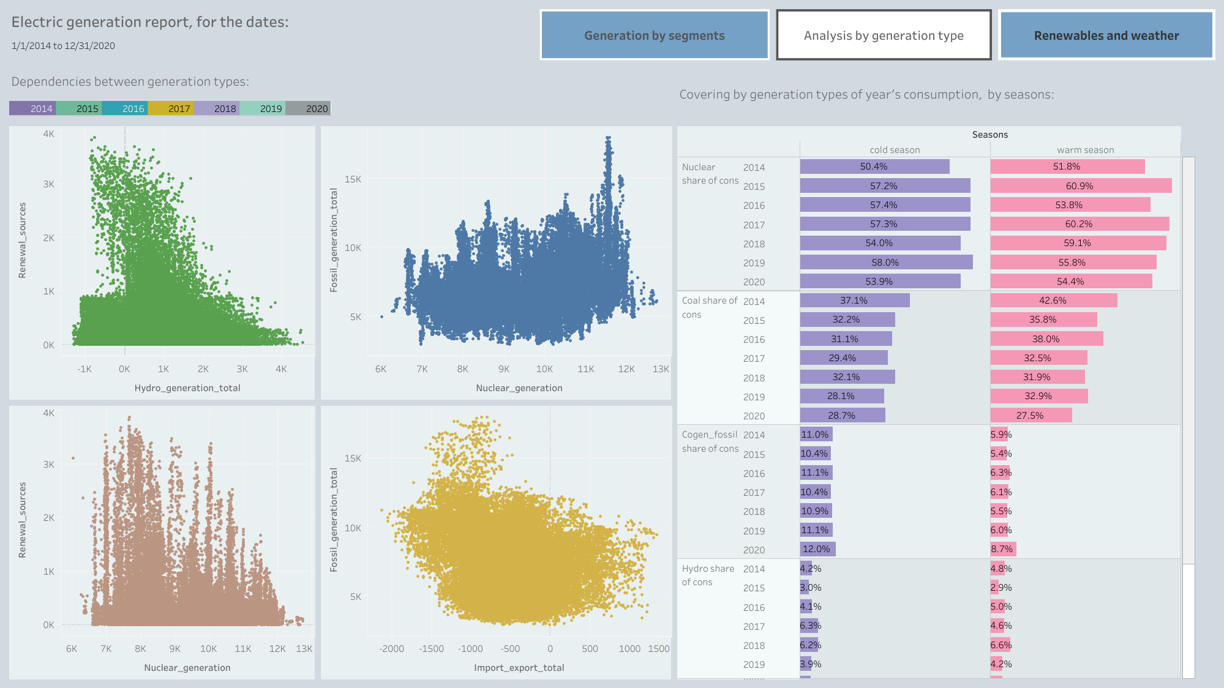

Slide 4
